Slide 1



South Carolina Opioid Settlement Funds
Fall Refresher
Coffee Chat

Slide 2


GPS Fall Refresher
Implementation Plan
Budget
Reporting

Slide 3
Guaranteed Political Subdivision Fund Applications
Technical Proposal
https://scorf.sc.gov/apply-for-funds/technical-proposal-requirements
To be approved for funding, all requests for Guaranteed Political Subdivision Subfunds must include the following:
1. Clearly identify the geographic area and/or communities that the request for funds will impact, including the population of the proposed service area, the poverty level of the service area.
2. Describe any existing efforts (either provided by your organization or others in the community) and provide an explanation of how this new effort will not be duplicative or will substantially expand existing efforts.
3. Please provide a description of any existing budget, funding or resources that you have received, including dollar amounts that support the foundation of the proposed project and/or are being leveraged to support the proposed project.

Slide 4
GPS Implementation Plan Example
Initial/continuation
Strategy: D. Address the Needs of Criminal Justice-Involved Persons
Strategy D.4: Provide evidence-informed treatment, including MAT, recovery support, harm reduction, or other appropriate services to individuals with OUD and any co-occurring SUD/MH conditions who are incarcerated in jail or prison.
Implementation Plan: Currently, there are many inmates in the Hudson County Detention Center due to substance use and drug-related charges. The Detention Center and the inmates are requesting treatment services while they are incarcerated. We are requesting $63,000 in funding to continue the employment of a clinical counselor dedicated to providing evidence-informed treatment for incarcerated individuals at the Hudson County Detention Center. This counselor offers comprehensive services, including biopsychosocial assessments, service plan development, individual counseling, and peer support. These services are vital in addressing the underlying issues that contribute to substance use and ensuring that individuals receive the support they need both during and after incarceration. Inmates can request these services through the detention center kiosks, with the nurse coordinating the scheduling of assessments and services through local substance use treatment center.
In year 1, $63,000 was budgeted to hire the clinical counselor. The counselor completed 75 assessments, 263 individual treatment sessions, lead 250 group therapy sessions and connected 26 inmates to post release services. By continuing these funds, we can continue our efforts to reduce overdose risk, provide critical treatment services, and ultimately support the health and well-being of those transitioning back into the community from incarceration. This initiative saves lives and fosters a safer, healthier Hudson County

Slide 5

GPS Process and Outcome Measures Example
Process Measure: Increase clinical counseling and recovery support for inmates incarcerated in the Hudson County Detention Center through a collaborative partnership to provide evidence-informed treatment-appropriate services to individuals with OUD and any co-occurring SUD/MH conditions, as identified through the detention kiosks/nurse.
75 assessments – 275 individual sessions – 250 groups – 50 post release connections
Outcome Measure: Increase access to critical counseling and recovery supports for at least 75% of Hudson County Detention Center inmates with OUD and any co-occurring SUD/MH conditions.
Budget for strategy: $63,000

Slide 6

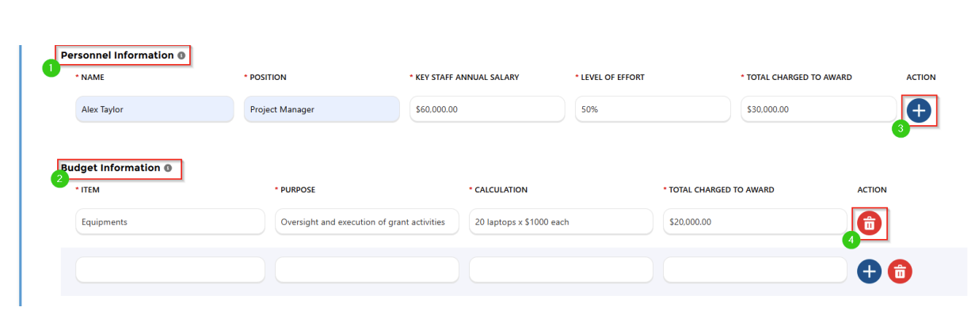
Budget

Slide 7
Budget Justification
A budget justification is a narrative explanation of each of the components of the budget, which “justifies” the cost in terms of the proposed work. The explanations should focus on how each budget item is required to achieve the aims of the project and how the estimated costs in the budget were calculated. The budget justification should:
• Explain why each of the requested items is necessary to accomplish the proposed project.
• Be organized in the order of the detailed budget page.
• Make it clear that all budget requests are reasonable and consistent.

Slide 8
Budget Justification
PERSONNEL:
Peer Support(s): One Peer Support Person is budgeted for X calendar months The PS will be responsible for__________________.
Program Manager/Project Coordinator/etc.: One __________ will devote X months to this The ____________ will [assist the PI with activities on this project.]
EMPLOYEE BENEFITS:
Fringe Benefits are charged as direct costs and include Employee Benefits (EB). Fringe rates are 40% or less of the requested salary.

Slide 9
Budget Justification
Materials and Supplies: are budgeted at $______The money will be spent on ________________________. [Due to the nature of the project, material and supply costs are estimated based on the knowledge of prior projects of similar scope.
Explain line item by line item why the material/supplies are needed.
Travel: Funds are requested for the [Position] to attend one out of state conference (for example, to the [Name of annual conference]) (for training, presenting, etc.. )
Funds are requested for the [position] to travel to in state conference/training, etc., for the purpose of…..

Slide 10
Budget Justification Checklist
Does the budget justification follow the same order as the budget?
Does the budget justification give additional details to explain the costs included in the budget?
Does the budget justification include only items allowable, reasonable & allocable?
unallowable expenses
Is the budget justification easy to read (short paragraphs, headings for different budget categories, etc.)?
Is the budget justification concise?
Do the numbers in the budget justification match those in the budget?

Slide 11
Budget Justification Checklist
Be sure everything in your budget and budget justification is referenced in the proposal description/narrative as well—and be sure everything mentioned in your proposal description that would incur cost is explained in the budget and budget justification!
Remember, all costs must be reasonable, allowable, and allocable:
Allowable refers to costs that may be charged to a grant or contract.
Allocable refers to costs that are necessary for the success of the project.
Reasonable refers to actions a prudent business person would employ.

Slide 12
Earned Interest on SCORF Funds
Guaranteed Political Subdivisions (GPS) must maintain all SCORF funds received in an insured, interest-bearing account. Interest must be earned on all SCORF funds received in advance of expenditures and/or on funds received but expenditures were delayed.
Interest earned on GPS SCORF funds and unexpended funds (carry over)must be applied to new requests for disbursement as additional funds are requested.

Slide 13
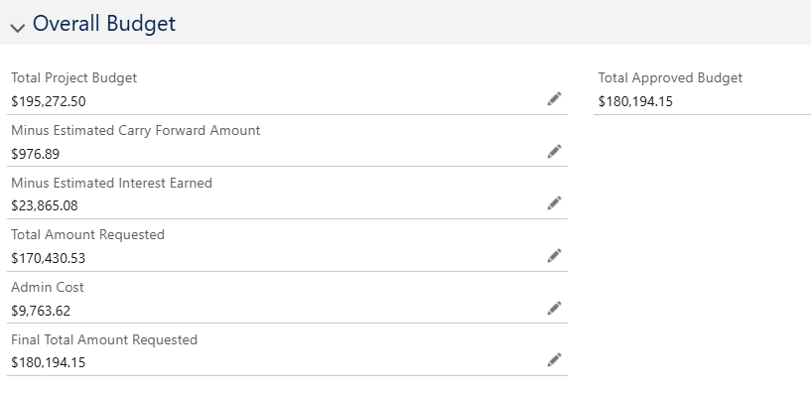
Earned Interest on SCORF Funds

Slide 14

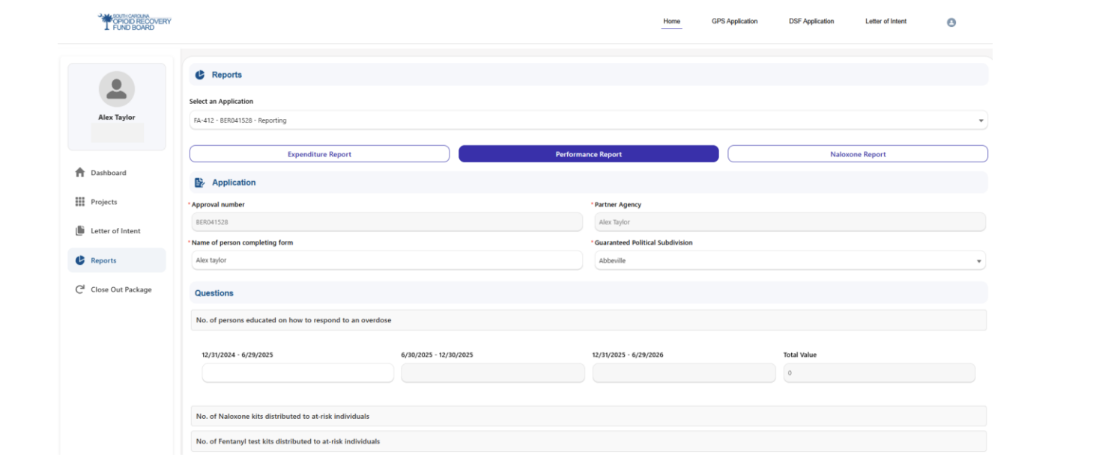
Program Reporting

Slide 15
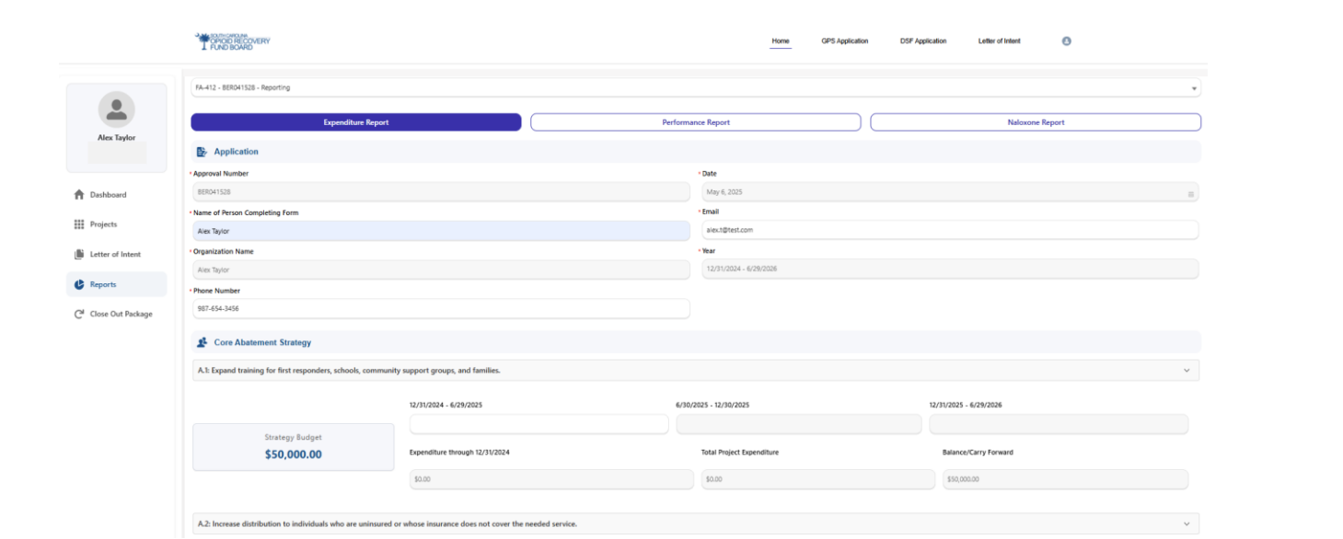
Fiscal Reporting

Slide 16

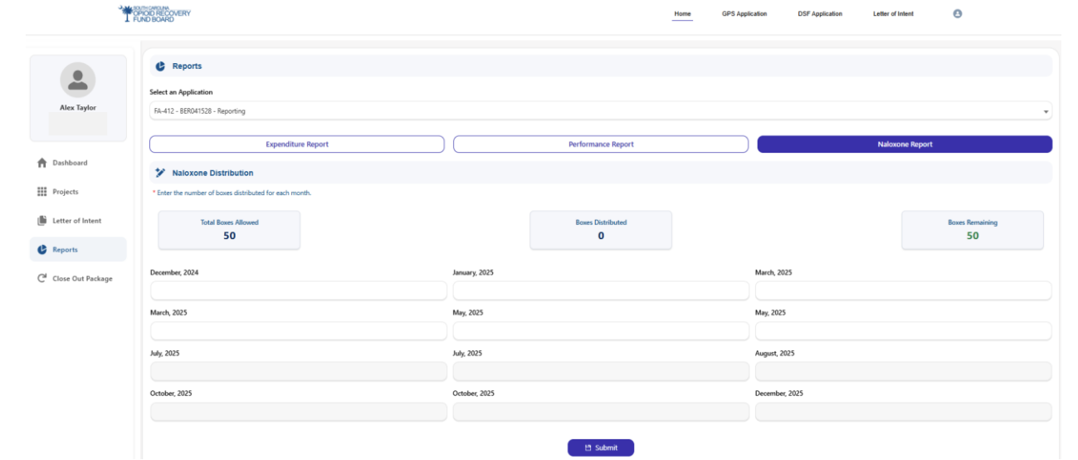
Naloxone Distribution Reporting
South Carolina Naloxone Saturation Dashboard

Slide 17

Questions??
Roberta Braneck
SCORF Program Administrator
803-898-3655
roberta.braneck@scorf.sc.gov
Matthew Williams
SCORF Project Coordinator
803-898-3673
matthew.williams@scorf.sc.gov

